Slide 1
ARM MTE Study
3/22 Update

Slide 2
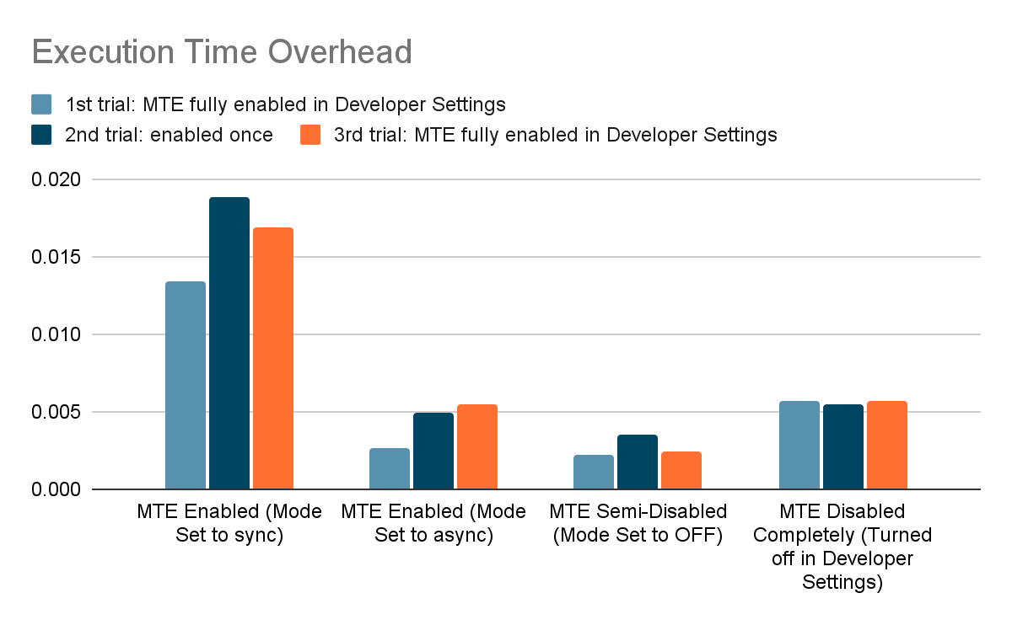
Benchmarking Updates: Execution Time Overhead
1000 iterations of memory intensive operations for mode = {SYNC, ASYNC, OFF} and MTE Disabled (Dis.)
SYNC average = 0.01633s
ASYNC average = 0.004349s
OFF average = 0.00276s
MTE Dis. average = 0.00562s

Slide 3
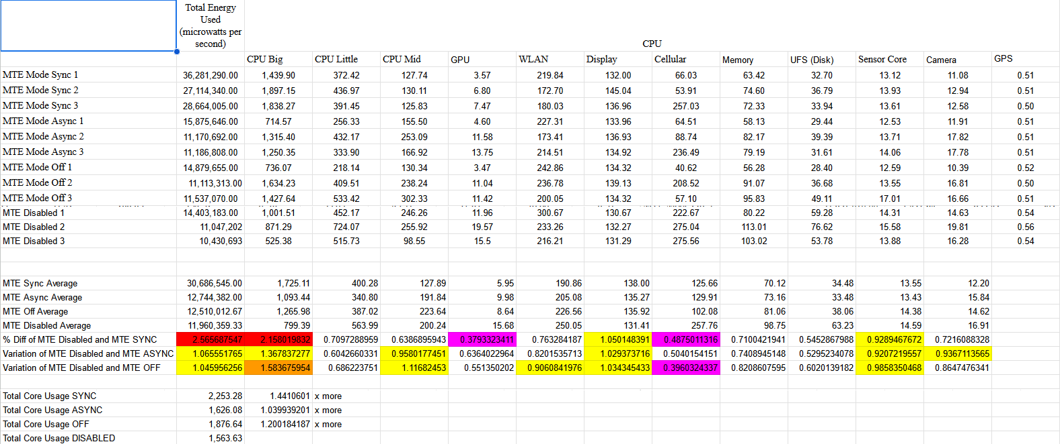
Power Usage Analysis

Slide 4
New Github Security Post on MTE…
Exploit: CVE-2023-6241 - A local non-privileged user can exploit a software race condition to perform improper memory processing operations. If the system’s memory is carefully prepared by the user, then this in turn causes a use-after-free.
Gain arbitrary kernel code execution and root on the device
How:
They used an exploit that targets the JIT memory management in the Mali GPU, where a race condition allows for unauthorized growth of a memory region during GPU fault handling. This discrepancy between the actual and intended memory sizes can lead to the GPU accessing freed memory pages.
The exploit mechanism involves creating a JIT region, inducing a GPU fault to grow the region improperly, and then manipulating the size of this region to misalign the GPU's page table entries.
This misalignment results in retained access to freed memory pages, which can be exploited to achieve kernel code execution by rewriting critical memory structures.
How it’s MTE related (kinda is, kinda isn’t)
The exploit does not rely on dereferencing corrupted memory blocks or pointers, which MTE prevents

Slide 5
IDEA - Increasing swap
Reserved MTE memory
Free memory
Swap
?
MTE Reserved Region grows
MTE Reserved Region is fixed
Reserved MTE memory
Reserved MTE memory
Free memory
Swap
Free memory
Swap
This should be observable

